Slide 1
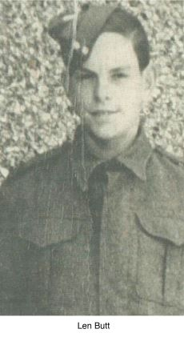
A Sapper’s D-Day
by Len Butt
1925 - 2021
A local chap who in October 2015, received
the Legion d’Honneur medal for his part in D-Day.

Slide 2
With less than a year’s service, I found myself posted to 184 field company Royal Engineers. At the time this unit was stationed on what was then, Netley Common on the outskirts of Southampton.
It was a large tented camp which the unit was sharing with the Nova Scotia Highlanders of Canada and the Canadian Engineer Company.
On arrival I was to discover that my Unit together with 83 and 84 Field Companies and 619 Field Park Company (ie Bulldozers, Plant etc) were the ‘Engineer‘ element for the 3rd Canadian Divisions Beach Group and, as such, we would be in the forefront of the Division’s assault on the ‘Atlantic Wall’.
I was 18, very green and with no previous experience of landing craft.
My only experience would be on Exercise ‘Fabius III’. This took place at the beginning of May when we sailed out of Southampton to land the following morning at the Witterings in West Sussex.
On returning after the exercise. we found that during our four days absence, the camp had been sealed off. (Apart from 2 occasions when we marched out to form up with other units of the Division for inspection by VIP's. First by Winston Churchill, General Smuts and Mr MacKenzie King and then by General Montgomery.) We were not to leave camp again until we embarked for D-Day.
The remaining days left to us before embarkation were hectic and an intensive whirl of final preparations, briefings and issuing of the specialist equipment we would carry with us.
2

Slide 3
Among these specialist items were what was known as ‘prepared charges’ explosive devices for demolition tasks.
Each of our sections would be required to carry a 25lbs ‘prepared charge’. Our Section Corporal held a ballot for the item and I drew the short straw. Sgt Brown. my Platoon Sgt was most comforting. We were re-rehearsing, loading and wearing our kit when he happened along. I was standing wearing my rucksack, equipment etc, some 100 lbs in weight. He stopped to check me over and, patting the ‘prepared charge’ perched on top of my rucksack, cheerfully informed me that, the charge was quite harmless until primed with the detonator and fuse. He went on to say that even if hit by a bullet it would be safe and then added, ‘unless it’s a tracer’. In that case I would save myself the shilling for a burial blanket. He wandered off chuckling. My reply to his humorous aside is unprintable.
The maps and models used for our briefings were in incredible detail. These, together with the aerial photographs, many taken at sea level, enabled us to form a very clear picture of our particular stretch of beach, including the beach obstacles and strong points awaiting us.
We discovered that we would be landing on Juno (Nan sector) Beach right in front of Bernieres-Sur-Mer, and that on disembarking we had to rendezvous by the sea-wall. There we would be met by our Platoon Officer (Lt. Phillips) and the reconnaissance Sgt and party who would have landed with the Assault Infantry (Queen’s Own Rifles).
We were due to land some 30 minutes after the first assault.
3

Slide 4
Towards the end of May we were issued with French Francs, thus leaving us little doubt as to our destination.
Thursday the 1st of June
Today the Company was addressed by the Commanding Officer. His main comments being:-
a That he considered it a privilege that we were wearing 3rd Canadian’s Divisional Flash and that we would be supporting the Divisional assault on the Atlantic Wall.
b He reminded us of the sacrifice by Canada at Dieppe in August 1942 and how the lessons of that tragedy would be of benefit to us in the task ahead.
c He concluded by expressing his confidence that we would all do our utmost in supporting the Division’s assault.
Saturday 3rd June
We awoke to discover the camp placed on instant readiness, (ready to move in one hour) and to be informed that as of now we were on ‘Active Service’. (My Army Discharge book clearly states - Service NW Europe 3.6.44).
We spent the day in an increasing state of tension. Each hour, seemingly longer, until just before last light. Then into the camp rolled a large company of TCV’s (troop carrying vehicles}. Within a very short time we had loaded up and were on our way into Southampton Docks.
4

Slide 5
As we approached the dock area, convoys were converging from all points of the compass. It was incredible. Yet such was the organisation and control that in a comparatively short time we had threaded our way to our allocated dock basin, where we unloaded and eventually embarked on our LCI—the same one we had used on exercise ‘Fabius III’. No mean feat in the near darkness loaded down as we were. It was amazing that no one finished up in the water as we had to scramble over several craft before reaching our own vessel.
Our LCI was quite a small vessel. Some 180’ long and with a very shallow draught, some 5’ at most.
My platoon accommodation was the forward hold.
A steel box some 20’ by 20’ lined round with tiers of steel bunk frames but no bedding because of the fire risk. This was our transport for the Channel crossing.
During the exercise ‘Fabius lll’, we had experienced balmy summer weather and had spent only one night on board.
Even then, under almost ideal conditions, we had found considerable discomfort. With cramped conditions and the overall pervading stench of diesel fumes, our Channel crossing would prove to be a far sterner test.
5

Slide 6
The morning of June 4th saw us still tied up in the Dock Basin. At about mid-morning we started out of the dock, but with the enormous number of craft involved it was hours before we cleared the docks area to start sailing up the Solent. Suddenly amazement! We were turning back and all around us other craft were following suit and we would spend the rest of the day returning to dock. Rumours started and then we noticed a rapid deterioration in the weather. It was nearly dark when we finally tied up once more. We were then informed of a 24 hour postponement. Even in the relative shelter of the dock basin, we were to spend a rough and fitful night.
Morning 5th June. With orders to leave our kit aboard, we were disembarked on the quay to feed and stretch our legs. We were confined to the dockside warehouse for this purpose.
Early afternoon we re-embarked, noting some improvement in the weather. Later afternoon saw us once again underway. The previous 24 hours had been a considerable trial with everybody getting keyed up and tempers fraying. Now, suddenly, everything seemed to change. We could almost feel the urgency of our craft as we progressed up the Solent.
We were fortunate in being allowed on deck at this time for as we progressed, what a sight to behold. Before our eyes the Solent was filling with ships and landing craft.
From the enormous dock complex of Southampton, from Portsmouth Harbour, the Hamble and every conceivable inlet, endless streams of vessels were converging and forming into convoys.
6

Slide 7
At approximately 8pm, our flotilla was sailing in line fairly close to the Isle of Wight shoreline.
Sailing close to and parallel with us were lines of ‘Fighting Chasseurs’ carrying the 1st SS (Special Service} Brigade commanded by Lord Lovat who, in the morning, would land on ‘Sword Beach’ to go to support the 6th Airborne Division.
As we passed Osborne House, with its manicured lawns and its buildings glistening in the evening sunshine, so the sound of Bagpipes echoed across the water. Played, I believe, by Piper Mullen.
Cheers rolled across the Solent. It was a moment I would never forget.
Shortly afterwards, the Platoon Sgt. opened his copy of the sealed orders. Then to inform us that the die was cast.
In the morning we would be on the coast of Normandy. Shortly after this momentous news we were ordered off deck. With a last look at home, I went below, in the knowledge that I was in good company as a member of the Third Expeditionary Force to sail to the Continent in the past 30 years, and that history was in the making.
As we cleared the eastern tip of the Isle of Wight heading for the assembly area some 10 miles out, we became fully aware how rough the seas still were in the aftermath of the storm that had delayed D-Day. Our craft was buffeted by waves 5’ to 6 ‘ high and we were all very soon reduced to a state of inertia. The only relief from the monotony was at about 1am when the air Armada carrying the 6th Airborne passed over. We could hear their passing even above the pounding of the waves. By morning nothing would deter us from waiting to leave our storm-tossed craft and landing on Terra Firma.
Came the dawn and we struggled to sort ourselves out and prepare for events. We shortly received orders to kit and get into our positions for landing. I was fortunate to be No.2 in the queue to go down the starboard gangplank (although not appreciated at the time). This meant I was up on deck sheltering behind the forward hatch but, able to see over both sides of the craft.
7

Slide 8
From approximately 10 miles out, we started our run into the beach.
What an astonishing sight to behold. First we pass close to HM ships, Warspite, Ramillies and the Lord Roberts. All engaging shore targets with their main armament. Next we pass very close to HM Scylla, Flagship of the Eastern Task Force. Then HMS Belfast and Diadem, and finally through the destroyer and gunboat screen. Everyone seemed to be shooting. The noise was deafening.
With about a mile to go we received the warning for beaching and, hitching up our kit, we awaited events. At this time I was fully aware of the 25 lbs of explosive perched on my back.
With a hard jolt we beached and I found myself instinctively following Sgt. Brown down the gangplank, plunging off into the chest-high water we waded ashore. To my amazement, there in front was the sea-wall at Bernieres. We had landed exactly as planned during briefing.
As previously ordered, we quickly gathered by the sea-wall and began to take stock. We were not left waiting. Sgt Brown quickly started to issue orders and I found myself with my section ordered to clear mines from the dunes on top of the sea-wall. The rest of the Platoon was set to work on the mass of obstacles along the foreshore; many of these being mined. Armoured bulldozers were already at work and AVRE’s had already flailed and blown 2 exits off the beach.
8

Slide 9
The landings at Bernieres had been further delayed by bad weather. Starting some 30 minutes late. This was to cause a considerable handicap in the beach clearance, with the tide racing back in to cover many obstacles before they could be finally cleared. It would take until early afternoon before the beach could be reasonably cleared. Nevertheless, sufficient progress was made to enable the follow-up Brigade and Artillery units to start landing some two hours after the H-Hour.
On starting our clearance task, I found myself as No.1 in a clearance team - i.e., operating a mine detector. Thus equipped, I started to sweep the area chosen. I stopped almost immediately. There staring at me was my very first mine. Indicating to my No.2 whose job it was to mark the mines as found, he came forward to place a marker. Then he too stopped.
We looked at each other and then back at the mine. Neither of us had seen or been instructed concerning the mine in question. (It turned out to be Belgian.)
This type of problem would occur again before the end of the day. Too late, it was realised that during our all too brief training in the UK, many of us had seen and handled only British, German and Italian types of mines.
The problem was overcome but only at the expense of unnecessary casualties. In the meantime, work had to proceed.
On landing few of us paid much attention to the conditions on the beach, being intent on
reaching our RV point by the sea wall; but now as we got down to work, we began to realise how fortunate we had been. There were a considerable number of casualties around.
As well as wrecked tanks and landing craft all along the beach, we now discovered that all of our reconnaissance party were among the casualties. Lt. Phillips, the sergeant and two of the sappers were dead. By the end of the day some 20% of the Platoon would be among the toll.
9

Slide 10
About two hours after H-Hour, the follow-up Brigade started landing. We were quite surprised when from a fresh wave of LC I’s the Nova Scotia Highlanders came streaming ashore carrying folding bicycles. At the time, Jerry was still barely a mile up the road and one of our wags called out that they wouldn't be able to claim mileage allowance.
Nevertheless, the Nova Scotians would have the last laugh by making the deepest Infantry penetration inland on D-Day.
Early evening an alarm was raised to the effect that a German counter-attack had broken through to the beach between us and Sword Beach. Everyone stood to. We awaited events with some apprehension. Time ticked by with tension mounting. Suddenly from across the channel came the sound of many aircraft. The noise getting clearer and louder. Rising above the current sounds all around us. And there, what a sight to behold. The 6th Air Landing Brigade coming in to reinforce the 6th Airborne Division. Some 500 tugs with gliders in tow.
As spontaneous cheering echoed around the beach, the gliders were detaching and swooping into land. Although the sky seemed to be filled with anti-aircraft fire, very few aircraft seemed to be hit.
With the arrival of the airborne reinforcement, all tension had vanished. The general feeling being that we were here to stay.
Just before last light, some 4 or 5 German bombers appeared overhead, dropping bombs at random. All being shot down for their cheek. It seemed to put the seal on D-Day. Although not quite.
As a young and green sapper, I hoped I had played my part on an ‘Historical’ day.
I had been lucky and had seen the D-Day sunset. Some did not.
Leonard G Butt D-Day Sapper 184 Field Coy.,R.E.
He was a local man and became a T.A Officer at Chichester Army Cadet Force
10

Slide 11
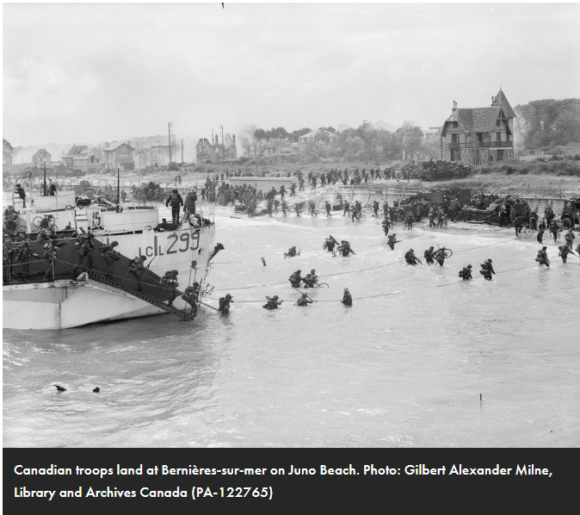
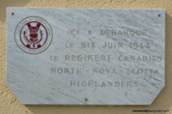
Troops of the 9th Canadian Infantry Brigade
(Stormont, Dundas,
and Glengarry Highlanders)
going ashore from
LCI (L) 299 [Landing Craft Infantry],
Bernières-sur-mer,
Normandy, France,
6 June 1944.
LANDED HERE ON THE SIX JUNE 1944 CANADIAN REGIMENT
NORTH-NOVA-SCOTIA HIGHLANDERS
Flags of the 13 countries involved in D-Day
United Kingdom, Canada, Belgium,
Czechoslovakia, Netherlands, Norway
Greece, France, United States, Australia
New Zealand, Poland, Denmark
11

Slide 12
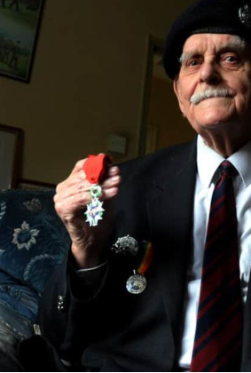
Captain Len Butt died aged 94 on Wednesday, March 24 2021
He is remembered for his good humour, great affection and for his work in keeping ‘hundreds’ of Chichester teenagers ‘on the straight and narrow’.
He led the Royal Sussex Army Cadet Force in Chichester from 1961 to 1982 and was subsequently one of the first recipients of the Chichester City Council Civic Award.
Friend and former Mayor Anne Scicluna said of Len: He always seemed so very good-humoured and believed strongly in what he was doing to help the lads, many of whom went on to join the army themselves. Hundreds of young people have cause to thank him for the help and attention he gave them in their teenage years.
I later knew him also as the man who organised the functions for the Royal Sussex Regimental Association and it was always a real pleasure to attend their dinners, often as his personal guest. Len was immensely proud to be one of the very first recipients of a Chichester City Council Civic Award in 1986 and he attended almost all the subsequent award ceremonies, proudly wearing his own award badge as well as his war medals.
In recent years, as a long-standing member of the Chichester City Club, he used to take a taxi every Wednesday to meet his friends in the club. There he was to be seen every week, clutching his large glass of shandy and surrounded by his many friends, until the taxi came back to pick him up to go home. Many times also, he would invite some of those friends to share a lunch with him at the club.
A very large number of local people, young and old, have cause to remember Len Butt with thanks, with pleasure, and with great affection. A real character, who will be much missed by many people.
October 2015
Len Butt, one of the first recipients of a Chichester civic award in 1986,
was thrilled to receive the
Legion d’Honneur medal for his part in D-Day.
Produced by Ruth Heelan email: ruth.heelan@talktalk.net
Website: Southbournehistory.uk
Facebook: Southbourne (West Sussex) Community Group
12

